Slide 1
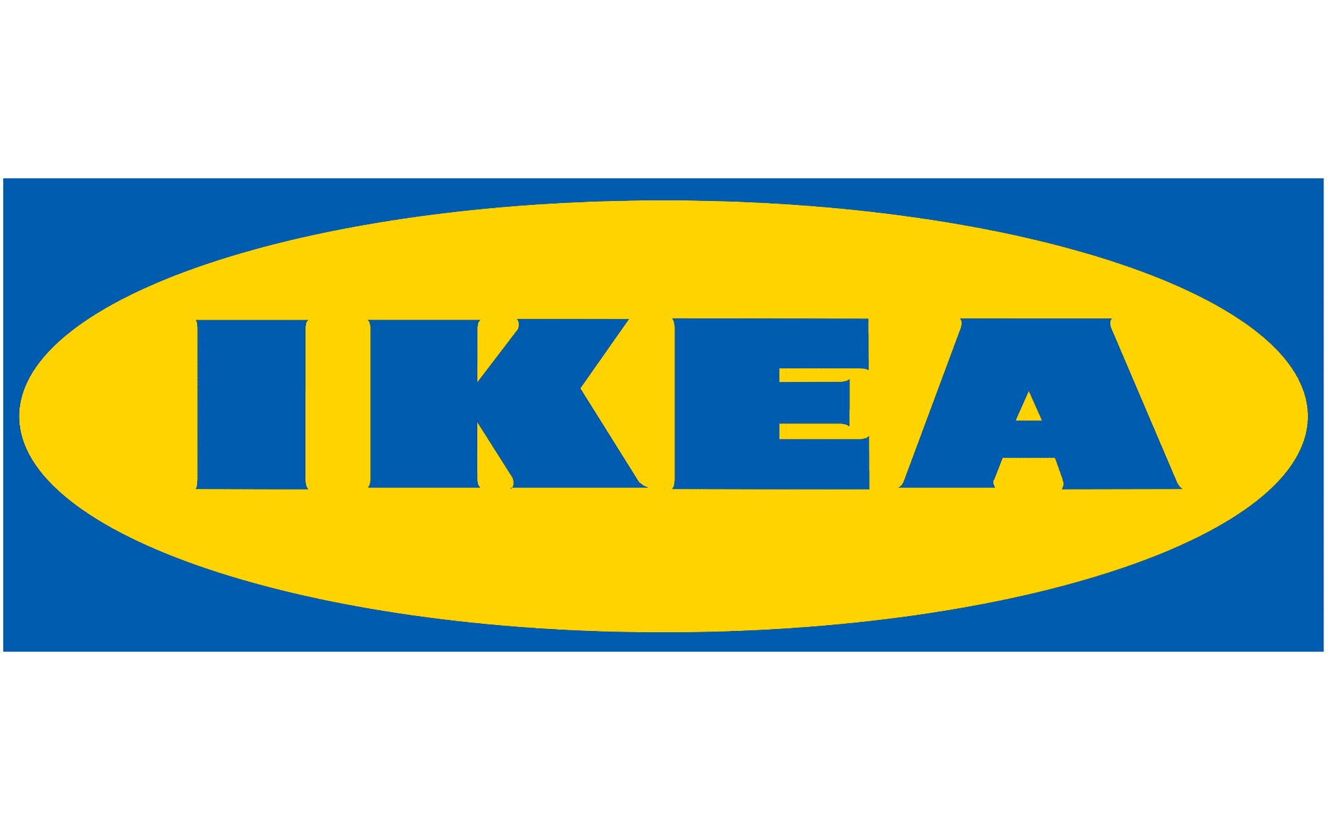

Organization: IKEA
Vision: To create a better everyday life for the many people.
Mission:To offer a wide range of well-designed, functional home furnishing products at prices so low that as many people as possible will be able to afford them.
Strategy Theme: Business Growth, Social Impact, Sustainability Practices
Strategy Objectives and Strategy Map
Measures
Targets
Financial
Increase Revenue
Decrease Costs
Return on Investment
Net profit
Operating costs
ROI
+5% y-o-y
- 3% y-o-y
- 20%
Customer
Customer Retention (Loyalty)
Increase Customer Base
Improve customer experience
Retention rates
Customer growth rates
Customer feedback
80% retention
+ 5% y-o-y
>80%
Internal Business Process
Improve existing range of products
Increase products and services
Reduce climate footprint
New products/services sales %
End user feedback
Carbon footprint index
3% this year
>80%
10% reduction in C02 (tonnes)
Learning and Growth
Upskilling
Culture of innovation
Leadership development
No. of employee development plans
Training take up rates
+20% y-o-y
70% uptake rates
Notes:
Notes: In recent years, IKEA has been a forerunner in branding themselves as eco-friendly through many measures taken to uphold sustainability and remain popular among the masses, leading to their strategy theme…
Financial: Increase Revenue: Decrease Cost: Implement cost-saving measures in manufacturing and supply chain. Optimize product portfolio to focus on high-margin items.Expand online sales and click-and-collect services to reduce overhead costs. Investment on sustainability Practices: Product Design and Materials, Manufacturing and Supply Chain. With this, it can help to attract new customers, improve brand reputation and more.
Targets: IKEA has been having stable profit growths annually, hence they hope to maintain their steady growth through 5% increase in profits in the incoming year…
Customer: Customer retention (loyalty): membership, Omnichannel, agent experience, Mobile self-support, order tracking, conversational support through social media and remote design support Increase customer base: Explore new markets or segments while maintaining a strong presence in existing ones. Develop innovative and affordable furniture designs that cater to diverse needs and preferences.
Improve customer experience: Service, retail experience (change out of VM), etc. Improve in-store experience with clear navigation, helpful staff, and interactive displays. Offer personalized online shopping experience with recommendations and wishlists. Provide high-quality customer service through multiple channels (phone, online chat, etc.).
Targets: IKEA has a loyal customer following through their entire range of services and products, such as IKEA memberships, hence they hope to keep at least 80% of their customers by encouraging them to renew their memberships and increase their new customer base by 5% through attractive food and furniture deals for members…They hope to maintain at least 80% of positive feedback through swift customer service. Internal Business process: Improve efficiency - Invest in automated systems for logistics and inventory management. Streamline supply chain processes to reduce lead times and costs.Invest in automated systems for logistics aImplement continuous improvement programs to identify and eliminate waste.
Increase range of products and services: to cater to demand and trend, Design support, Hotel
Improve existing range of products: Making it even simpler to fix, quality etc. Targets: IKEA seeks to remain competitive and modern in the furniture market, hence aims to have 3% gross sales for their new products, and while aiming to reduce their carbon footprint by 10% carbon/tonnes
Learning and growth: Upskilling: Provide ongoing training and development programs for employees. Culture of innovation: Encourage employee engagement and participation in decision-making processes.Invest in research and development to create new products and services. Collaborate with startups and universities to explore new technologies and trends. Leadership Development:
Targets: To upskill and value their employees’ growth, they aim to increase their employee development programmes by 20% and review its popularity among employees with a 70% take up rate

Slide 2
Name | PI
WANG NAN YAN | J2181895
TAN BOON KIM | J2271277
LU WEN TING | E2371484
KEN ONG WEI HONG | Q2371323

